Slide 1
CI/CD for distributed teams
Merge requests, GitOps and real-world examples (GitLab-CI and EKScalibur)

Slide 2
Agenda
Introduction
Merge requests
GitLab CI and code sharing
GitOps
EKScalibur examples : infrastructure and application

Slide 3
Introduction
Today every team is a distributed team due to WFH and teams structure.
We are not going to touch anyway of working like agile / scrum methodologies during this session.

Slide 4
Merge Requests
Named Pull Requests in Github, Gitea, Bitbucket etc
Merge request is
Why? a feature that makes it easier for developers to collaborate.
How? a mechanism for a dev/user to notify others about a set of changes (that could be representing a feature)
What else? a place to log / discuss / review the feature and its implementation

Slide 5
GitLab CI - walkthrough
Merge requests in GitLab
When / how to manage MR?
Maintainer vs developer
Gitlab templates

Slide 6
Merge requests
Is a merge request only useful for developers?

Slide 7
GitOps
GitOps is a way of implementing Continuous Deployment for cloud native applications.
The core idea of GitOps is having a Git repository that always contains declarative descriptions of the infrastructure currently desired in the production environment and an automated process to make the production environment match the described state in the repository GitOps: versioned CI/CD on top of declarative infrastructure. Stop scripting and start shipping. Kelsey Hightower

Slide 8
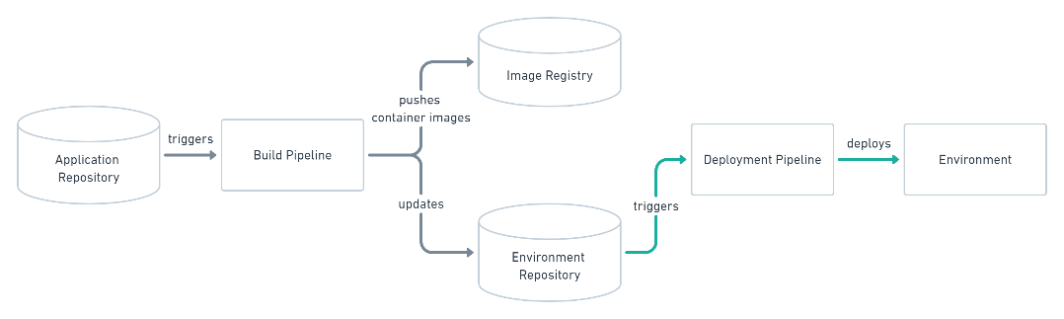
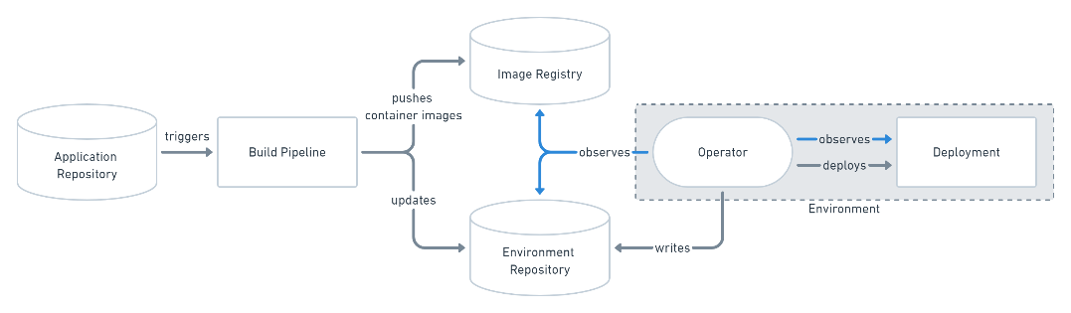
How does GitOps work?
Environment Configurations as Git repository GitOps organizes the deployment process around code repositories as the central element. There are at least two repositories: the application repository and the environment configuration repository.
Push-based Deployments
Pull-based Deployments

Slide 9
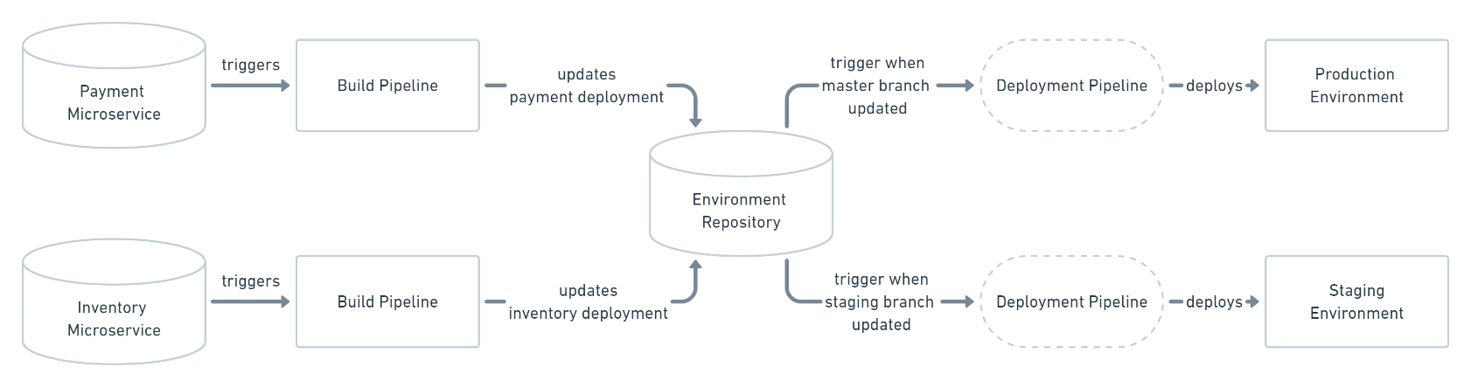
EKScalibur CI/CD
Inspired by GitOps Push-based deployment and adapted to meet our organisation.

Slide 10
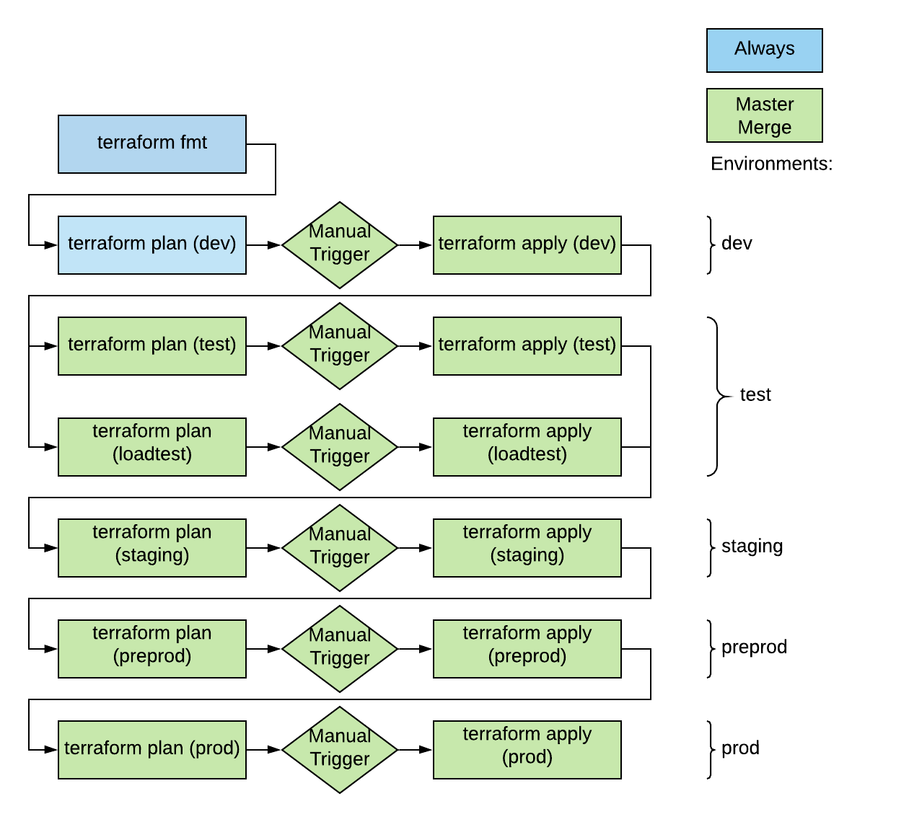
EKScalibur CI/CD - Infrastructure

Slide 11
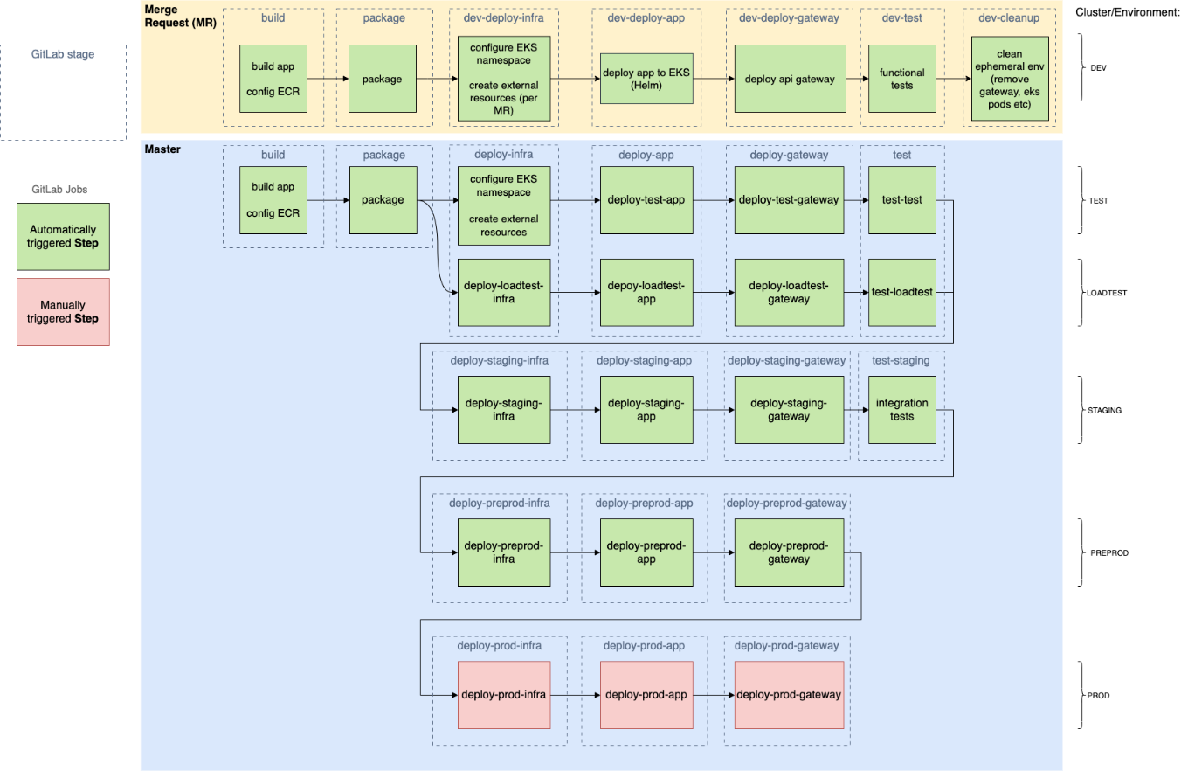
EKScalibur CI/CD - Application

